Slide 1
Week 5 Assignment
Final Software Project
John Home
The University of Arizona Global Campus
CST 499: Capstone for Computer Software Technology
Dr. Charmelia Butler
7/10/2023

Slide 2
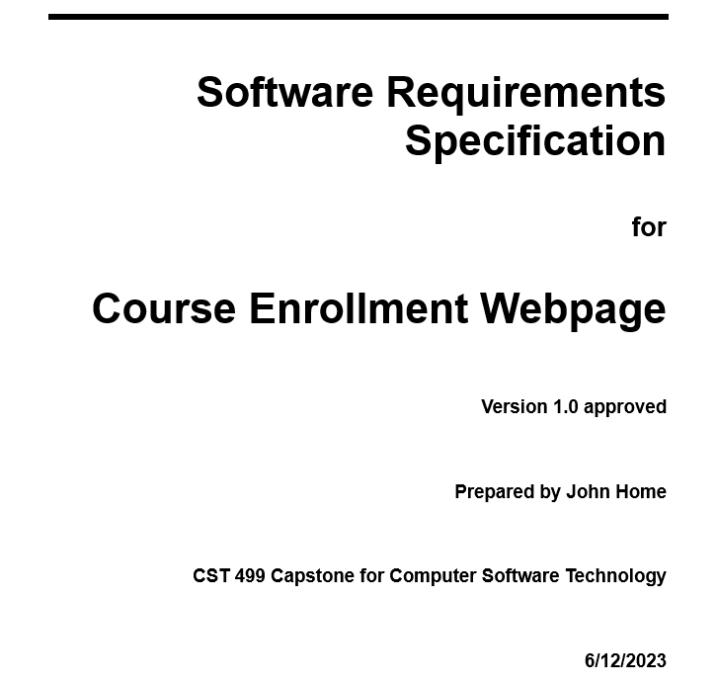
SRS Document
- Introduction
Purpose
Intended Audience
Scope
Description
Functions
Notes:
The SRS document I utilized allowed me to organize the requirements for this website project and build a picture of what I was designing. Within the SRS document I outlined the scope of the project, the different perspectives of the end users, and the functions that the product was going to need to perform. This was an important step because it helped me visualize what the website was going to look like. The introduction provides a space for the purpose of the software and who the software is going to be designed to be utilized by. The document itself was pretty easy to go through and fill out based on the requirements that were provided for the project.

Slide 3
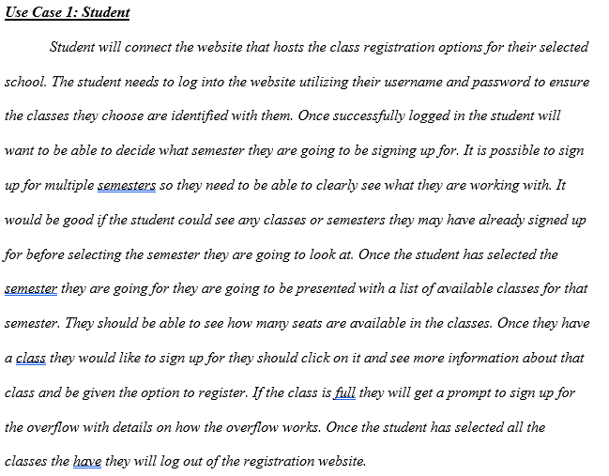
ULM Design Model
Use Case:
Helps understand how users will interact with the software
Walking through use case allows developers to see potential problem areas
Helps developers understand the environment the program will need to function in.
Notes:
I chose to utilize a use case design model to assist in determining how the software would be utilized. Going through a case that imitates what a user is going to be doing when they are trying to design the program helps to determine what areas are going to be difficult and what kind of information will be required for the software to be functional. I utilize use cases to get an understanding of what the user is going to be interacting with most and what I need to do to make the software as user friendly as possible in order to maximize the usefulness of the software.

Slide 4
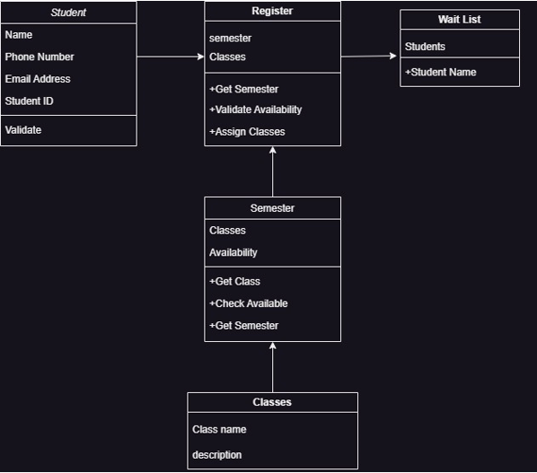
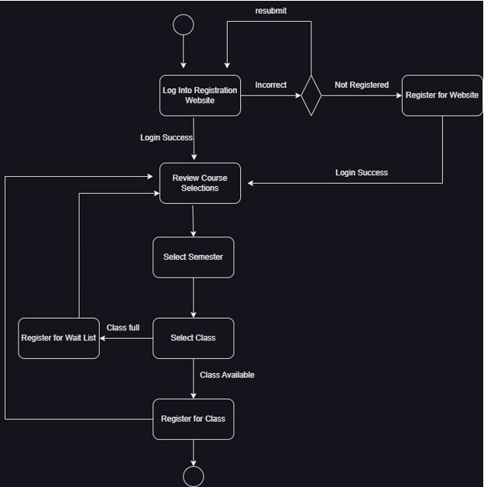
Notes:
I also utilized a class diagram and activity diagram for the software based on the use case. The class diagram helps me understand what the different objects I am going to need to create are. It also allows me to see how they are going to interact with one another. A class diagram allows me to analyze the different objects and determine if an object really needs to be on its own or if it can be combined into a different object. It also allows me to see objects that may need to be broken up into different parts.
The activity diagram helps me understand he flow of information within the software. I think this diagram is the most important since it helps build a picture of what needs to happen as the software is performing its functions. While building this activity diagram I was able to start to understand what different pages I was going to need and what functions could be combined into a single page. The activity diagram also assisted me in understanding where I needed to pay attention to situations where different results could occur. It helped me know when I needed to make sure the correct pages and information was displayed during different events.

Slide 5
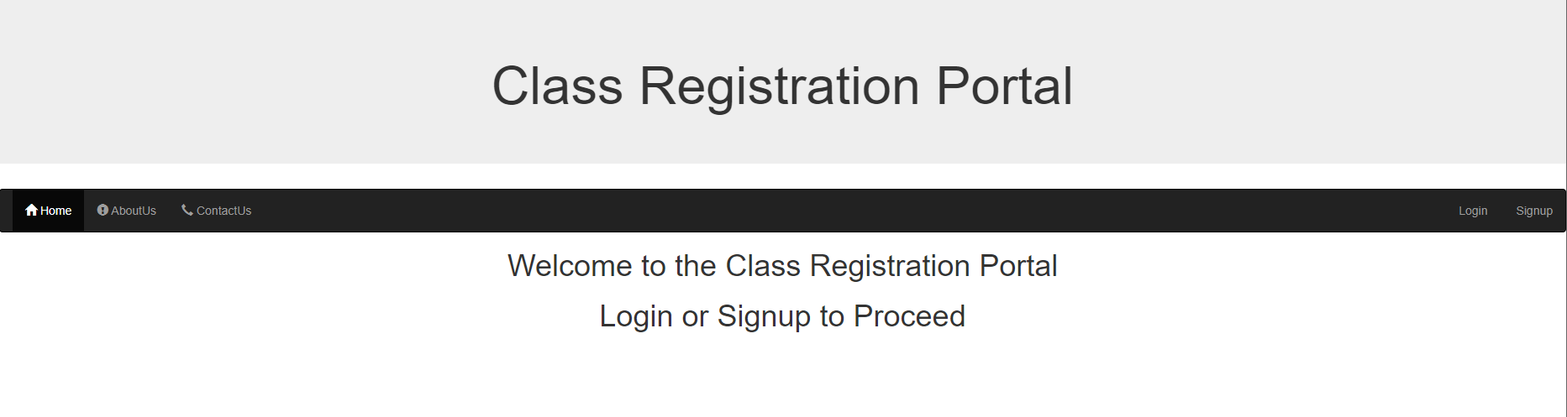
Landing Page
Landing page when user first arrives and has not logged in yet
Notes:
I really like to keep the initial landing page as clutter free as possible. I wanted the user to be able to move directly to logging in or signing up for the website. I knew at this point I needed to ensure that the landing page changed based on whether or not the user was logged in. This would determine what kind of information was presented to the end user.

Slide 6
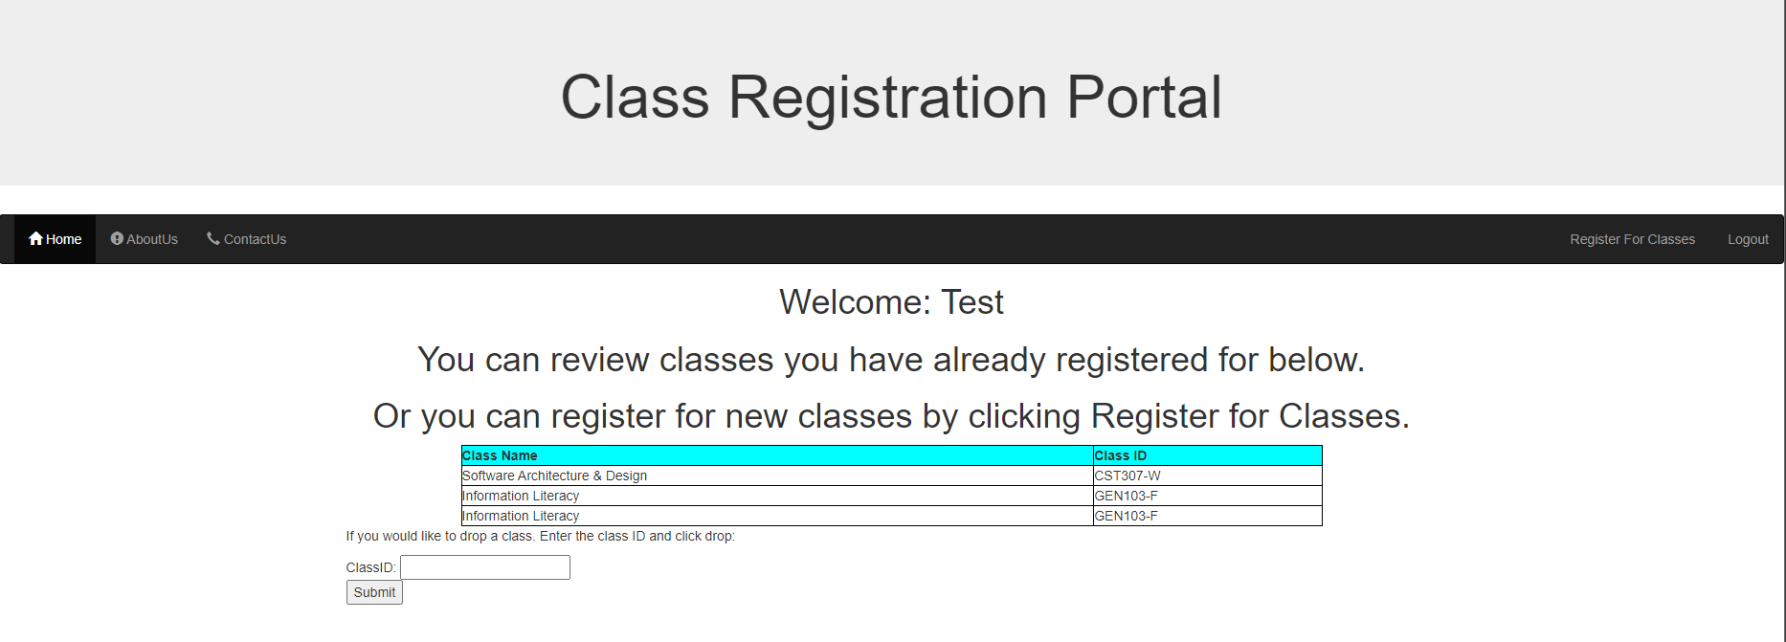
Notes:
The landing page after the user logged in shows the classes that they have registered for and allows them to remove themselves from classes if necessary. Again keeping the landing page as clutter free as possible I think helps the users to identify the information they need while signing up for classes.

Slide 7
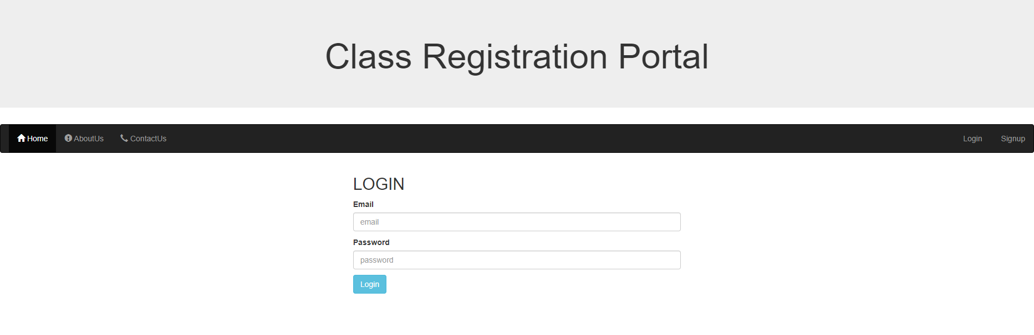
Login Page
Notes:
The login page is a standard login page. There is not a lot of information. If the user enters the incorrect username or password they will receive an error stating the incorrect username or password has been entered.

Slide 8
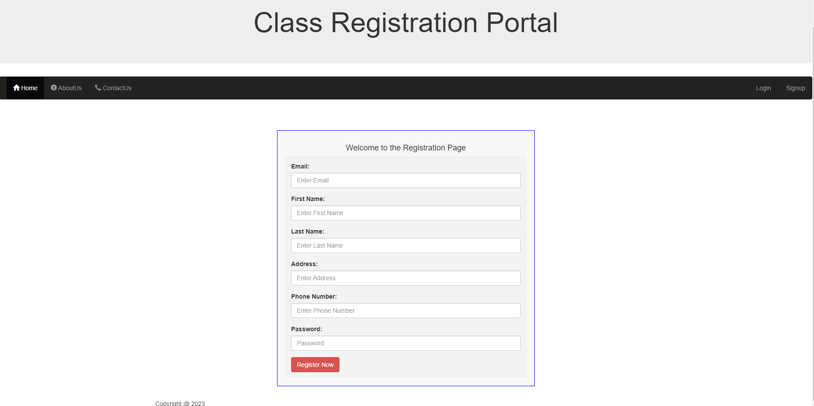
Notes:
If the user has not yet signed up for the website they can register through this form. It will take the information the user has entered and upload it to the back end database. Once the user is registered it will bring them back to the login page so they can sign in and get to the landing page for logged in users.

Slide 9
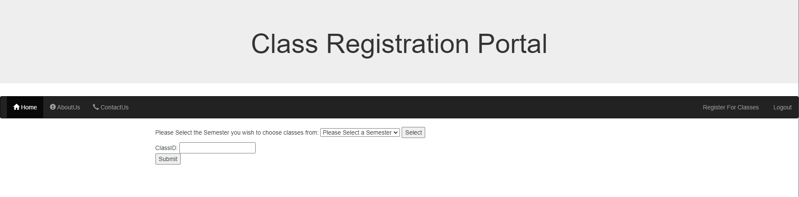
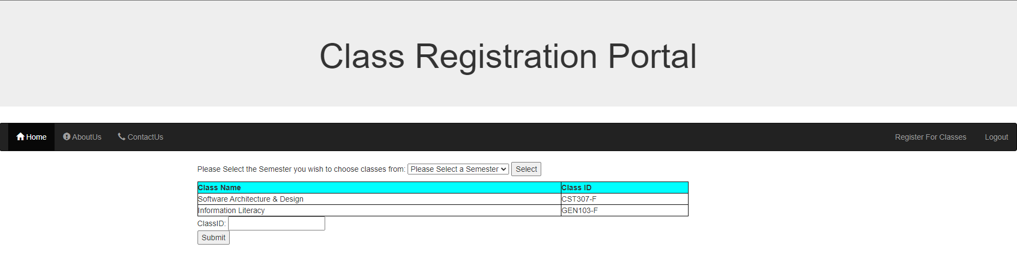
Enrollment Page
Notes:
The enrollment page allows the user to select the semester they are going to be registering for classes. They have the option between fall, winter and spring semesters. Once they select a semester the classes that are available for that semester are listed. The end user then puts the classID for the class they would like to register for in the class ID box and clicks the submit button to register for the class. If the class is full they will be taken to a screen that informs them the class is full and they have been added to the waitlist. The user is then able to go back to landing page.

Slide 10
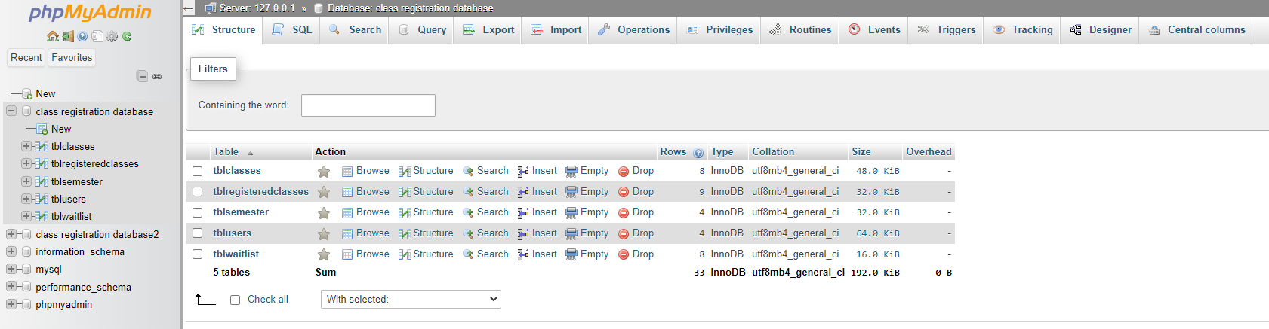
SQL Database
Notes:
The MySQL database houses the different tables that were created for this project. I created a table for the different classes, for classes that had registered users, a table for the different semesters, a table for the different users, and a table for the students that ended up on the waitlist. Whenever the students are interacting with he website the information they change is automatically uploaded to the MySQL database.

Slide 11
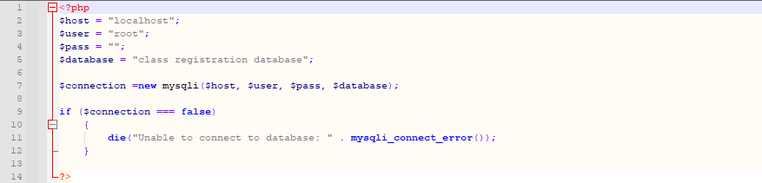
PHP Code
MySql connection code
Notes:
There is a lot of code for this project. The first snippet of code is the class utilized to connect to the database whenever information needs to be uploaded or retrieved. The code connects to the data base utilizing the local username and password. This connection then allows for additional MySQL code to be run.

Slide 12
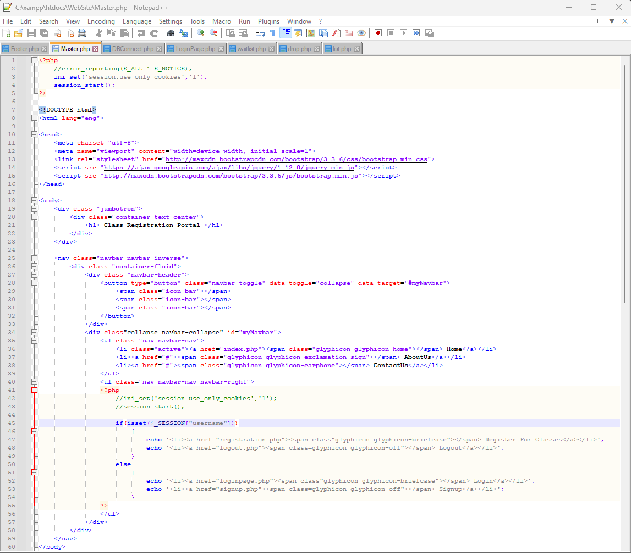
Master PHP
Provides layout for the rest of the website pages
Controls the task bar and header for all pages
Keeps the user information when they log in
Notes:
The master PHP file is utilized to set up the overall layout of the website and provide the quick links to the login page, registration page, logout feature, and sign up page. The master PHP file also stores the user information when they log in and allows it to be utilized by all the other pages within the website. The master page looks at whether the user is currently logged into the web page and changes what options the have on the task bar based on if they are logged in or not.

Slide 13
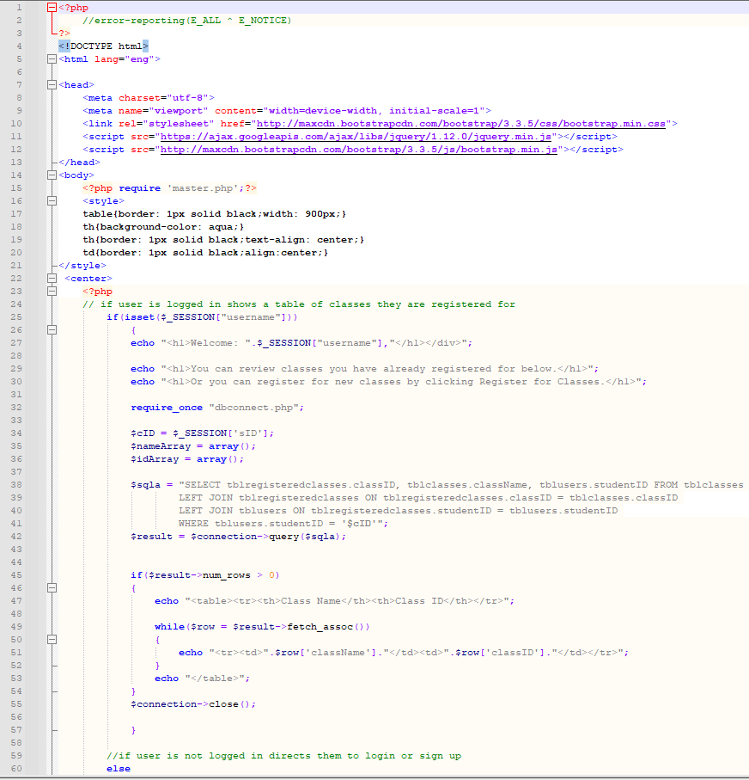
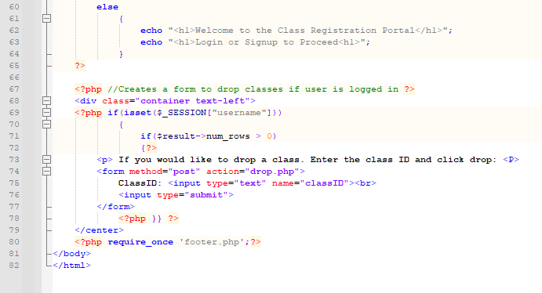
Notes:
The index page is the landing page for the website and performs a lot of functions. My goal was to allow the user to remain on the landing page as much as possible and receive the different options they needed to utilize the website to its fullest. This landing page took the most time to establish and make sure it was functioning. The code in the page looks at whether the user is currently logged in or not. If the user is not logged in it displays a message for the user to go log in or sign up for the site. If the user is logged in the if function then displays the different classes that are available.

Slide 14
References
Appache Friends (2023). Download. https://www.apachefriends.org/download.html
Bernal, B., Karam, O., & Tsui, F. (2018). Essentials of software engineering (4th ed.). Jones & Bartlett Learning. https://platform.virdocs.com/r/s/0/doc/2348054/sp/294215359/mi/864710041?cfi=%2F4%2F2%5Bch06%5D%2F6%2F4%5Bch06-sect1-002%5D%2F4%2C%2F1%3A0%2C%2F1%3A0&menu=table-of-contents
Carpenter, A. (2021). What is Integration Testing? https://www.codecademy.com/resources/blog/what-is-integration-testing/
Devi, K. (2023). What is Component Testing? https://www.browserstack.com/guide/what-is-component-testing

